Slide 1
University Outcomes
Understanding Key Performance Indicators for the Highest Ranked Universities
Margaret Ulrich
Jatin Patel
Nimisha Patel

Slide 2

Problem Statement
College ranking Vs. Graduation rate
College ranking Vs. Retention rate
Geo dispersion of colleges
College ranking Vs. SAT/ACT/Acceptance rate
College ranking Vs. Tuition rates
College ranking Vs SAT/ACT Scores

Slide 3


Data Sources
Kaggle.com
Known resource
Only the 230 top-ranked schools
A data gathering tool for tracking colleges for admission
Data set had a much greater number of schools

Slide 4
Data cleaning
We read in the US News CSV and dropped NaN rows. I then did something similar to the CollegeRaptor data.

Slide 5
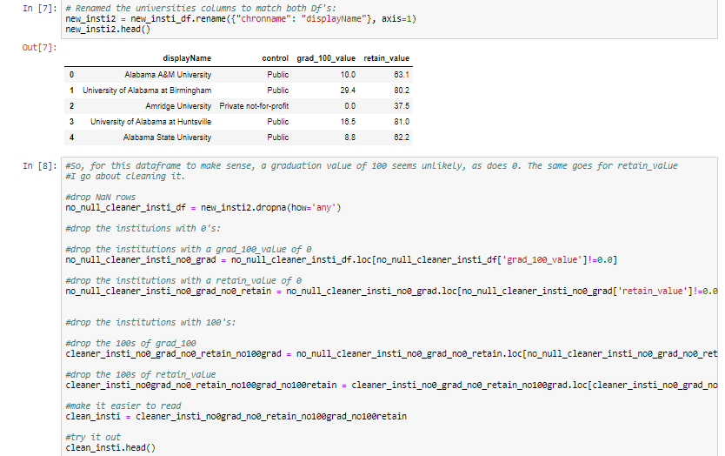

Slide 6
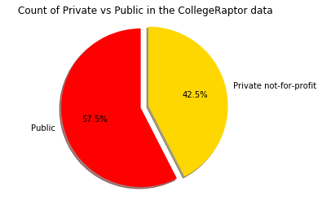
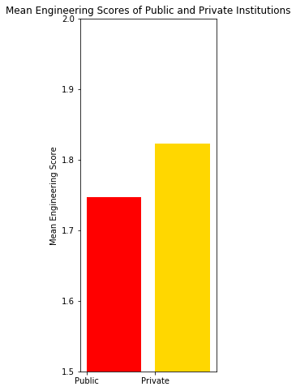
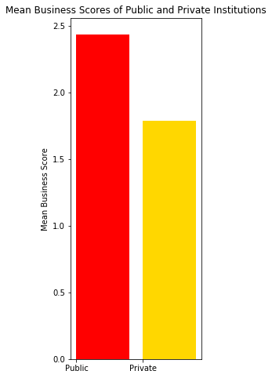
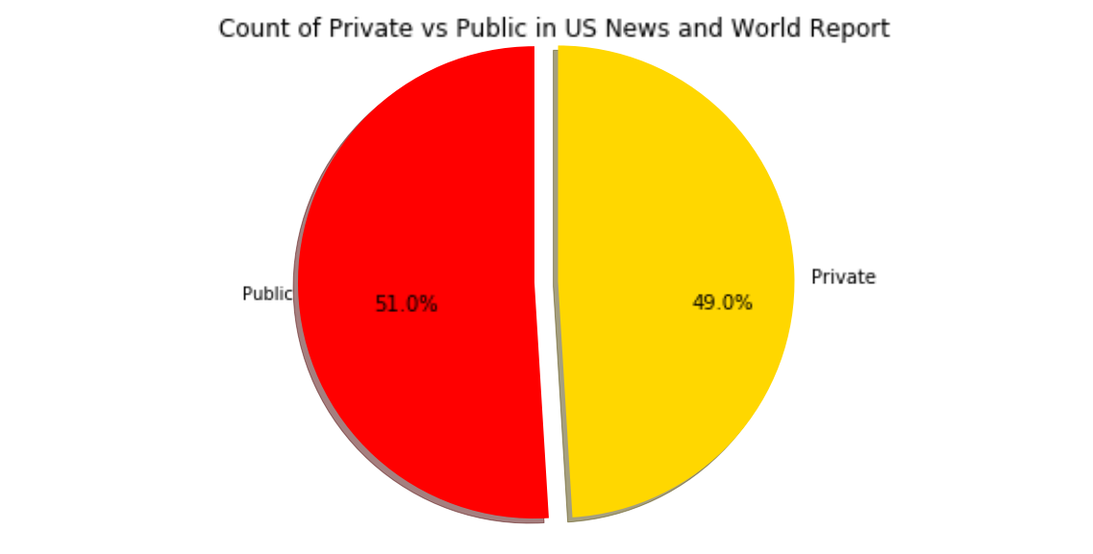
Since the bar charts pull from the data described in
The bottom pie, I feel that they might not be entirely
reliable.

Slide 7
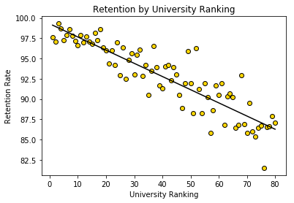
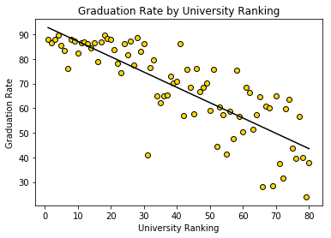

Slide 8
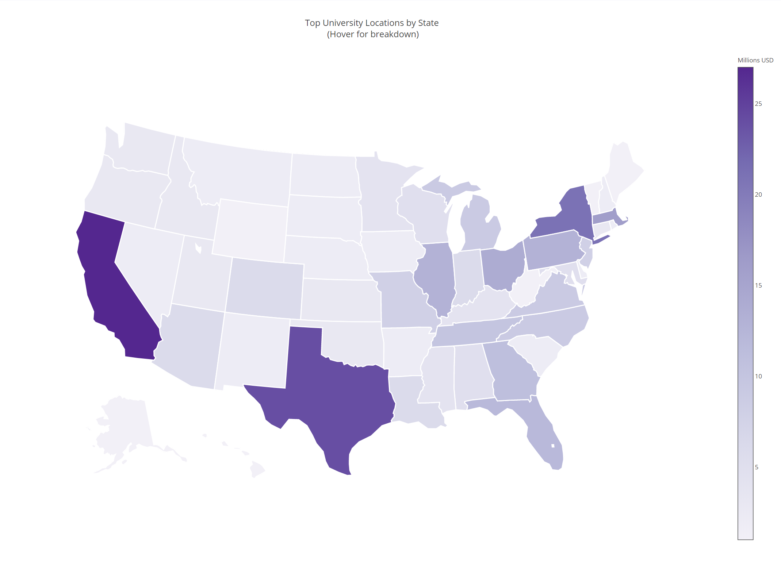
Top Ranked Colleges by the States
Analysis:
E and NE corridor has a higher concentration of top ranked colleges due to Financial and Industrial business.
California is leading in the West due to Silicon Valley.
Texas seems to have a higher concentration possibly due to Oil & Gas industry.
Conclusion: Industries play significant role in making of top colleges.

Slide 9
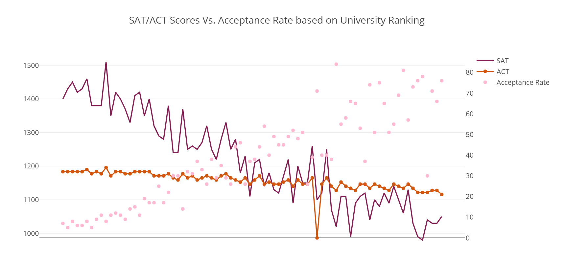
SAT/ACT Scores vs. Acceptance Rate by Top Colleges
Analysis:
Higher the college ranks, higher the SAT/ACT requirement thus lower the acceptance rate.
Lower the college rank, lower the SAT/ACT requirement thus higher acceptance rate.
Conclusion: SAT/ACT scores are inversely proportional to acceptance in the higher ranking colleges..

Slide 10
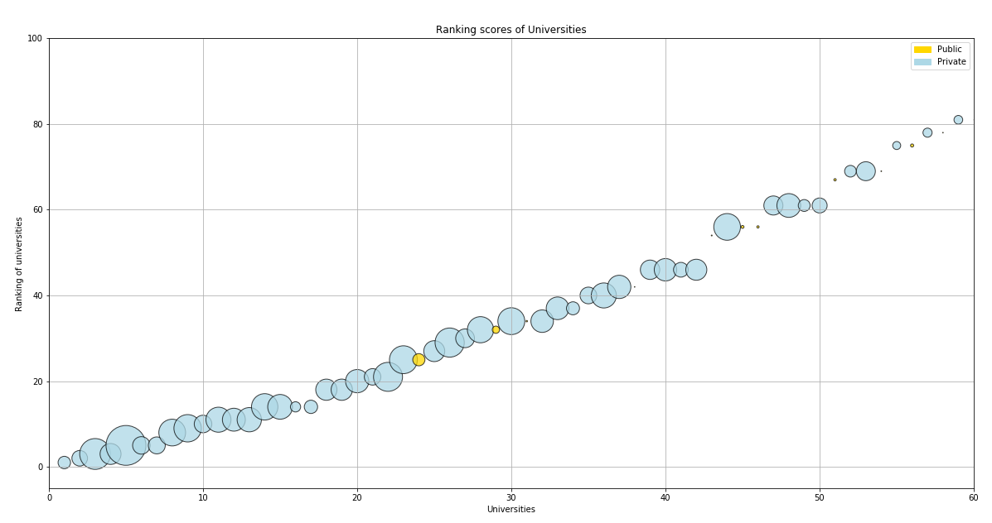
College Ranking Vs Tuition Rates
Analysis:
Trend of higher tuition and ranking
Public Colleges have low tuition
Less no of Private colleges
After a peak no linear pattern seen
Conclusion: Higher tuition in top 50 universities would be justifiable.

Slide 11
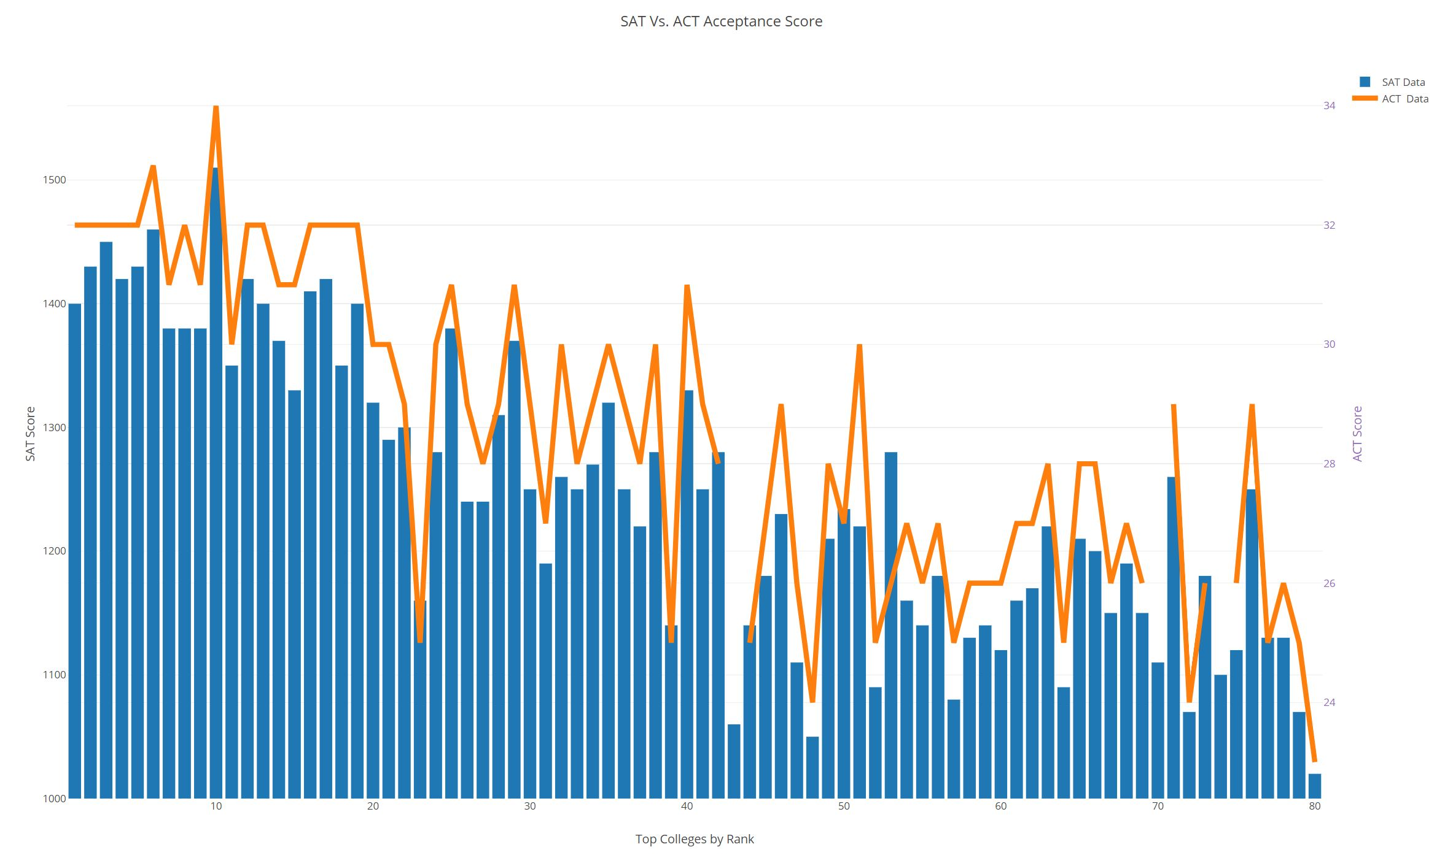
College Ranking Vs SAT/ACT Scores
Analysis:
Clear pattern seen for high SAT and ACT scores and ranking
SAT scores of 1375 and up is required for the top 10 colleges
ACT scores of 32 and up is required for top 10 colleges
Some colleges consider ACT scores more favorably than SAT scores
Some top ranked universities clearly show lower SAT/ACT requirements.
Other parameters are considered in ranking of top colleges.
Other parameters may include, course work, research grants, internship and job placements.
Conclusion: Top 10 colleges consider SAT and ACT equally.

Slide 12

Conclusion/Summary
Industries play significant role in making of top colleges.
SAT/ACT scores are inversely proportional to acceptance in the higher ranking colleges
Higher tuition in top 50 universities would be justifiable
Top 10 colleges consider SAT and ACT equally
College Rank is a primary indicator of Freshman Retention and Graduation Rate.
There does not seem to be much of a disparity between public and private

Slide 13
Q & A

